Slide 1
Approximation Algorithms (37.0)
When problem is in NPC try to find approximate solution in polynomial-time
Performance Bound = Approximation Ratio (APR) (worst-case performance)
  Let I be an instance of a minimization problem
  Let OPT(I) be cost of the minimum solution for instance I
  Let ALG(I) be cost of solution for instance I given by approximate algorithm ALG
  APR(ALG) = max _{I} {ALG(I) / OPT(I)}
APR for maximization problem =
  max _{I} {ALG(I) / OPT(I)}

Slide 2
Vertex Cover Problem (37.1)
Find the least number of vertices covering all edges
Greedy Algorithm:
  while there are edges
    add the vertex of maximum degree
    delete all covered edges
2-VC Algorithm:
  while there are edges
    add the both ends of an edge
    delete all covered edges
APR of 2-VC is at most 2
  e₁, e₂, ..., e_{k} - edges chosen by 2-VC
  the optimal vertex cover has ≥1 endpoint of e_{i}
  2-VC outputs 2k vertices while optimum ≥ k

Slide 3
2-approximation TSP (37.2)
Given a graph G with positive weights
Find a shortest tour which visits all vertices
Triangle inequality w(a,b) + w(b,c) ≥ w(a,c)
2-MST algorithm:
  Find the minimum spanning tree MST(G)
  Take MST(G) twice: T = 2 × MST(G)
  The graph T is Eulerian - we can traverse it visiting each edge exactly once
  Make shortcuts
APR of 2-MST is at most 2
  MST weight ≤ weight of optimum tour
    any tour is a spanning tree, MST is the minimum

Slide 4
3/2-approximation TSP (Manber)
Matching Problem (in P)
  given weighted complete (all edges) graph with even # vertecies
  find a matching (pairwise disjoint edges) of minimum weight
Christofides’s Algorithm (ChA)
  find MST(G)
  for odd degree vertices find minimum matching M
  output shortcutted T = MST(G) + M
APR of ChA is at most 3/2
  |MST| ≤ OPT
  |M| ≤ OPT/2
  |T| ≤ (3/2) OPT
odd

Slide 5
Non-approximable TSP (37.2)
Approximating TSP w/o triangle inequality is NPC
  any c-approximation algorithm can solve Hamiltonian Cycle Problem in polynomial time
    Take an instance of HCP = graph G
    Assign weight 0 to any edge of G
    Complete G up to complete graph G’
    Assign weight 1 to each new edge
    c-approximate tour can use only 0-edges -
    so it gives Hamiltonian cycle of G

Slide 6
3/2-approximation TSP
Christofides’s Algorithm (ChA)
  find MST(G)
  for odd degree vertices find minimum matching M
  output shortcutted T = MST(G) + M
The worst case for Christofides heuristic in Euclidean plane:
- Minimum Spanning Tree length = 2k - 2
- Minimum Matching of 2 odd degree nodes = k - 1
- Christofides heuristic length = 3k - 3
- Optimal tour length = 2k - 1
- Approximation Ratio of Christofides = 3/2-1/(k-1/2)
1
k+1
k+2
k+3
… 2k-1
1
1
2
3
4
… k
1

Slide 7
Steiner Tree Problem
Given: A set S of points in the plane = terminals
  Find: Minimum-cost tree spanning S = minimum Steiner tree
Euclidean metric
Terminals
1
1
Cost = 2
1
Cost = √3
Steiner Point
1
1
Rectilinear metric
1
Cost = 6
Cost = 4
1
1
1
1
1
1
1
1
1

Slide 8
Steiner Tree Problem in Graphs
Given a graph G=(V,E,cost) and terminals S in V Find minimum-cost tree spanning all terminals
MST algorithm (does not use Steiner points):
  find G(S) = complete graph on terminals
    edge cost = shortest path cost
  find T(S) = MST of G(S)
  replace each edge of T(S) with the path in G
  output T(S)

Slide 9
MST -Heuristic
Theorem: MST-heuristic is a 2-approximation in graphs
Proof: MST < Shortcut Tour ≤ Tour = 2 • OPTIMUM
Notes:
In the Moving-Target TSP formulation, there are a set of targets such that each target has an initial velocity and starting position.
A pursuer must find a tour which intercepts all of the targets in the minimum amount of time.
In this work, we also consider variations of the Moving-Target TSP formulation. These variations correspond to the a Moving-Target variant of the traditional Vehicle Routing Problem, where vehicles with fixed capacity must supply customers with fixed demand.
Vehicles may resupply at a central depot in order to service more customers. In our formulation, though, the customers, or targets, may be moving.

Slide 10
Approximation Ratios
Euclidean Steiner Tree Problem
  approximation ratio = 2/√3
Rectilinear Steiner Tree Problem
  approximation ratio = 3/2
Steiner Tree Problem in graphs
  approximation ratio = 2
2
1
MST Cost = 2k-2
3
Steiner Point
Opt Cost = k
4
Approximation ratio = 2-2/k ≈ 2
k
5

Slide 11
The Set Cover Problem
Sets A_{i} cover a set X if X is a union of A_{i}
Weighted Set Cover Problem
Given:
  A finite set X (the ground set X)
  A family of F of subsets of X, with weights w: F → ℜ⁺
Find:
  sets S ⊆ F, such that
    S covers X, X = ∪{s | s ∈ S} and
    S has the minimum total weight ∑ {w(s) | s ∈ S}
If w(s) =1 (unweighted), then minimum # of sets

Slide 12
Greedy Algorithm for SCP
1
2
6
3
4
5
Greedy Algorithm:
  While X is not empty
    find s ∈ F minimizing w(s) / |s ∩ X|
    X = X - s
    C = C + s
  Return C

Slide 13
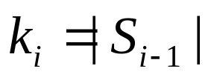
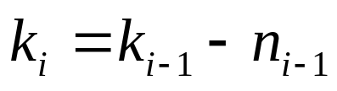
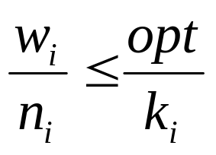
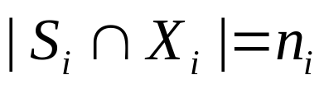
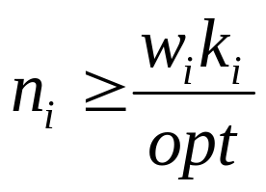
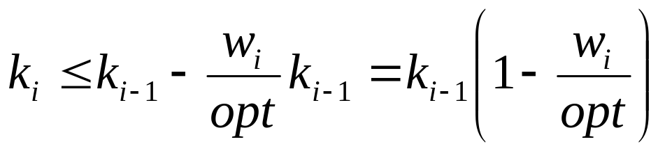
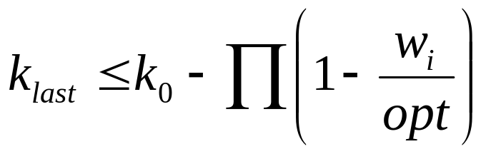
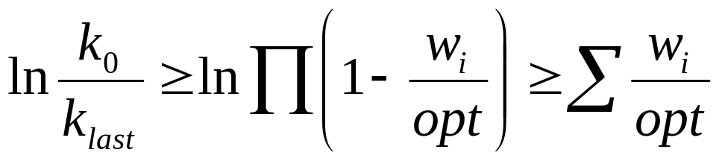

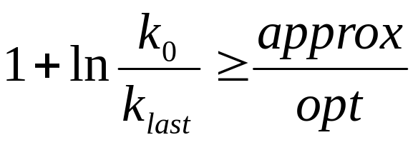
Analysis of Greedy Algorithm
Th: APR of the Greedy Algorithm is at most 1+ln k
Proof:

Slide 14
Approximation Complexity
Approximation algorithm
= polynomial time approximation algorithm
PTAS = a series of approximation algorithms
s.t. for any ε > 0 there is pt (1+ε)-approximation
  There is PTAS fro subset sum
Remarkable progress in 90’s (assuming P ≠ NP).
  No PTAS for Vertex Cover
  No clog k-approximation for Set Cover for k < 1
    k is the size of the ground set X
  No n^{1-ε} approximation for Independent Set
    n is the number of vertices

